Slide 1

9 Enneagram
Stephanie Teng

Slide 2
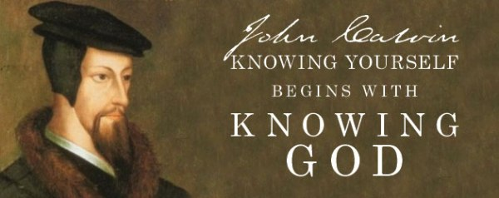
Notes:
1: Know yourself, like your strength and improve your weakness. Forgive yourself: Type 6, careful, they forgive their anxiety. Type 3: Change the job all the time.

Slide 3
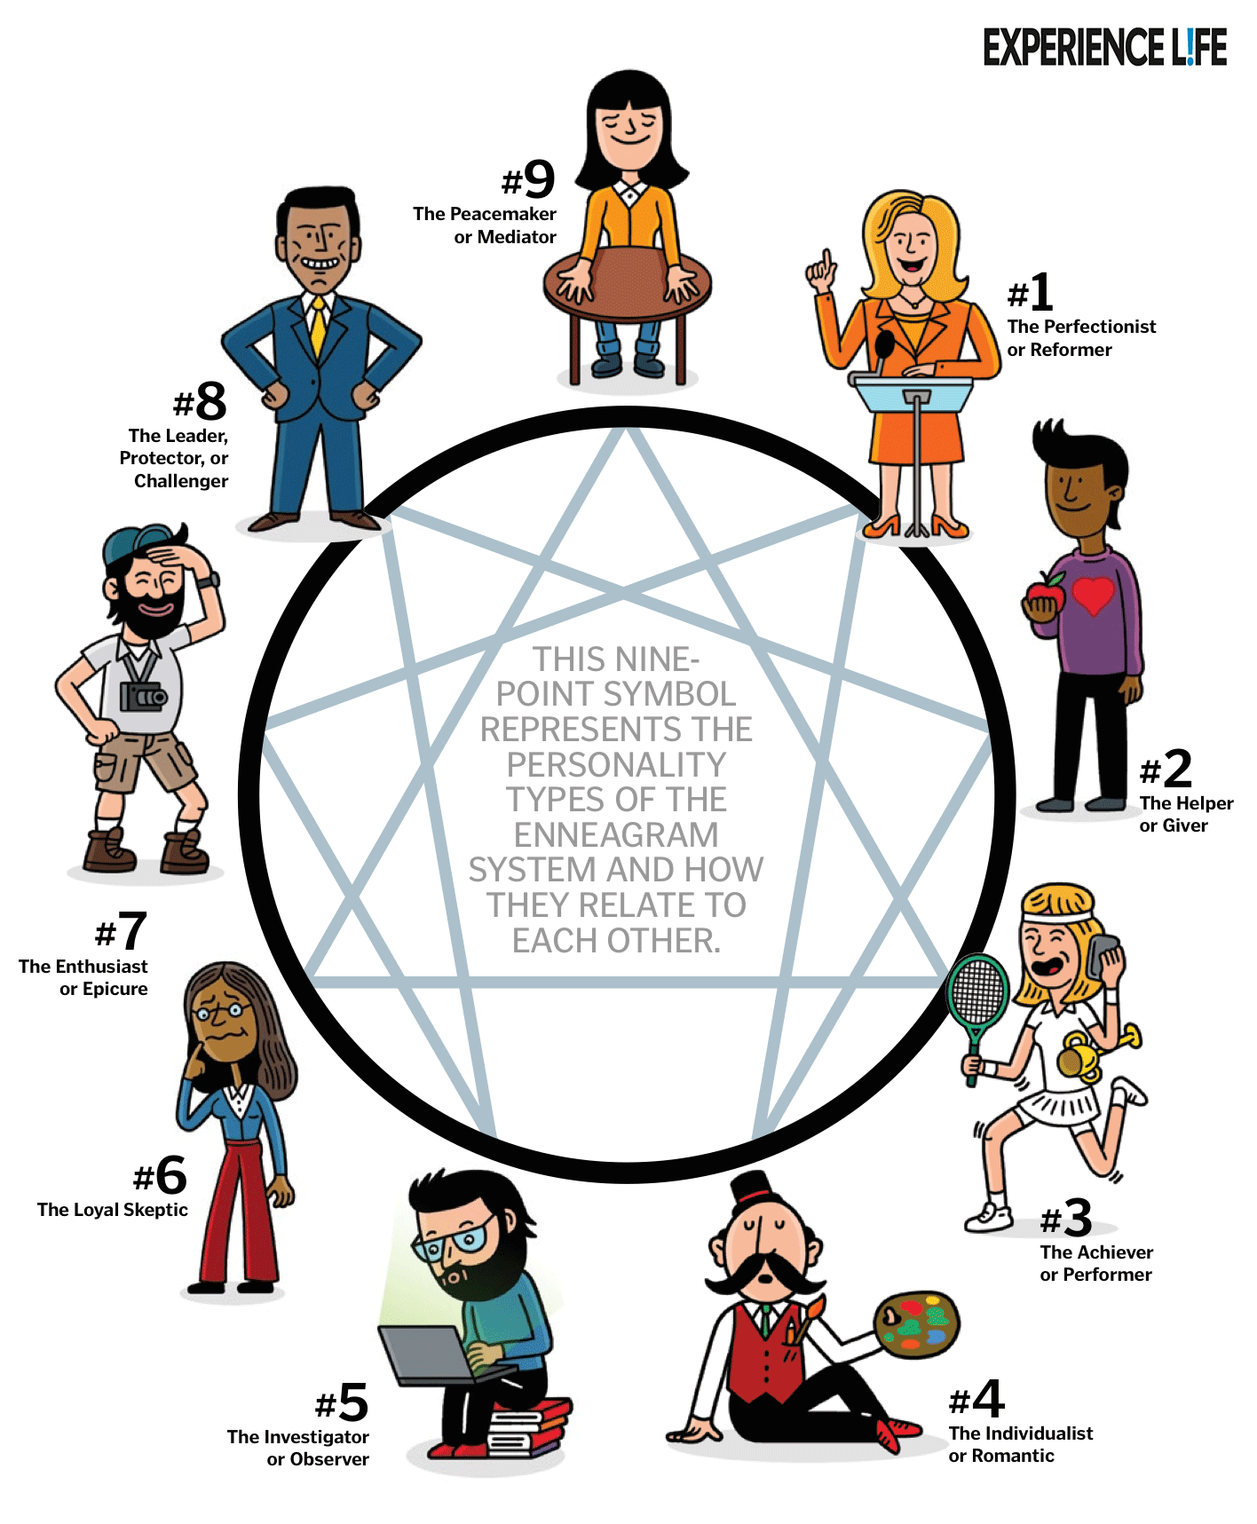
The enneagram is a motivation-based personality typing system. The enneagram discovered our motivation, fear, and desire in our characters.
It seeks to answer the underlying human question of “Why?”
ex: Why you are on time?
Type 1: It’s right thing to do
Type 6: Afraid to make mistakes ,be blamed
Type 3: Keep good image
Like your strength and improve your weakness. Help other to grow.
(John 10:14 "I am the good shepherd; I know my sheep and my sheep know me)
Notes:
1: Know yourself, like your strength and improve your weakness. Help you to see your blind spots (think other’s problem, like divorce, changing jobs). Be yourself and don’t be jealous of other. Forgive yourself: Type 6, careful, they forgive their anxiety. Type 3: Change the job all the time. Switch gear, when dealing with different type. Like Type 6 needs to prepare. Type 3, 8 needs big scale, for their tasks.

Slide 4
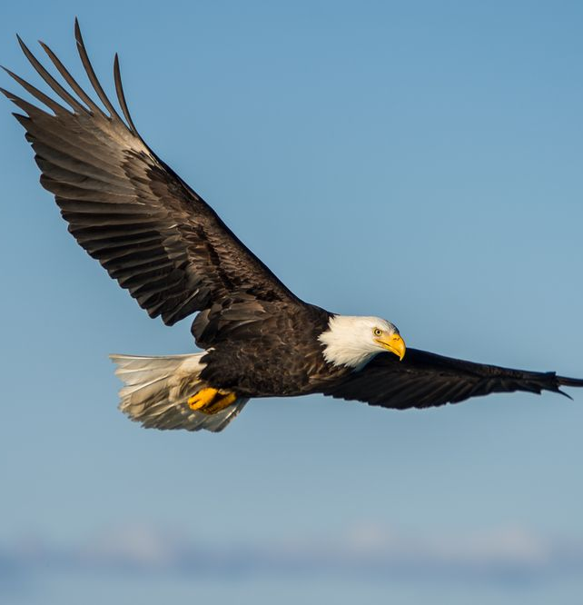
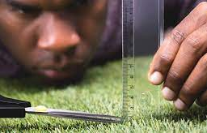
Type 1: Perfectionist
Characters: The Rational, Idealistic, Principled, Purposeful, Self-Controlled, and Perfectionistic
Key Motivations: Want to be right, to strive higher and improve everything, to be consistent with their ideals, to justify themselves, to be beyond criticism so as not to be condemned by anyone.
Basic Fear: Of being corrupt/evil, defective
Basic Desire: To be good, to have integrity, to be balanced
Healthy 1: Embrace life as an experience, rather than a problem to be solved. Laid back, hopeful.
Unhealthy 1: Moody, feeling misunderstood. Inflexibility.
Famous 1s: Jerry Seinfeld, Michelle Obama, Nelson Mandela, Ghandi

Slide 5

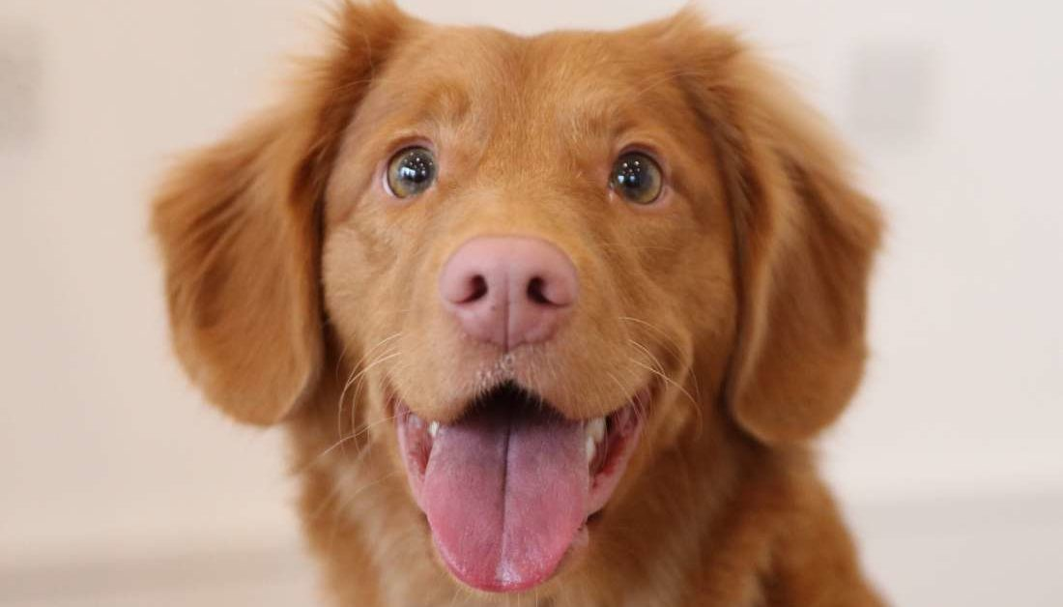
Type 2:Helper
Characters: The Caring, Interpersonal, Demonstrative, Generous, People-Pleasing, and Possessive
Key Motivations: Want to be loved, to express their feelings for others, to be needed and appreciated, to get others to respond to them, to vindicate their claims about themselves.
Basic Fear: Of being unwanted, unworthy of being loved
Basic Desire: To feel loved
Healthy 2: Confident in their own passions and purpose. Not centered around others’ needs.
Unhealthy 2: Prideful, stubborn, and headstrong.
Famous 2s: Paula Abdul, Stevie Wonder, Bill Cosby, Madonna

Slide 6

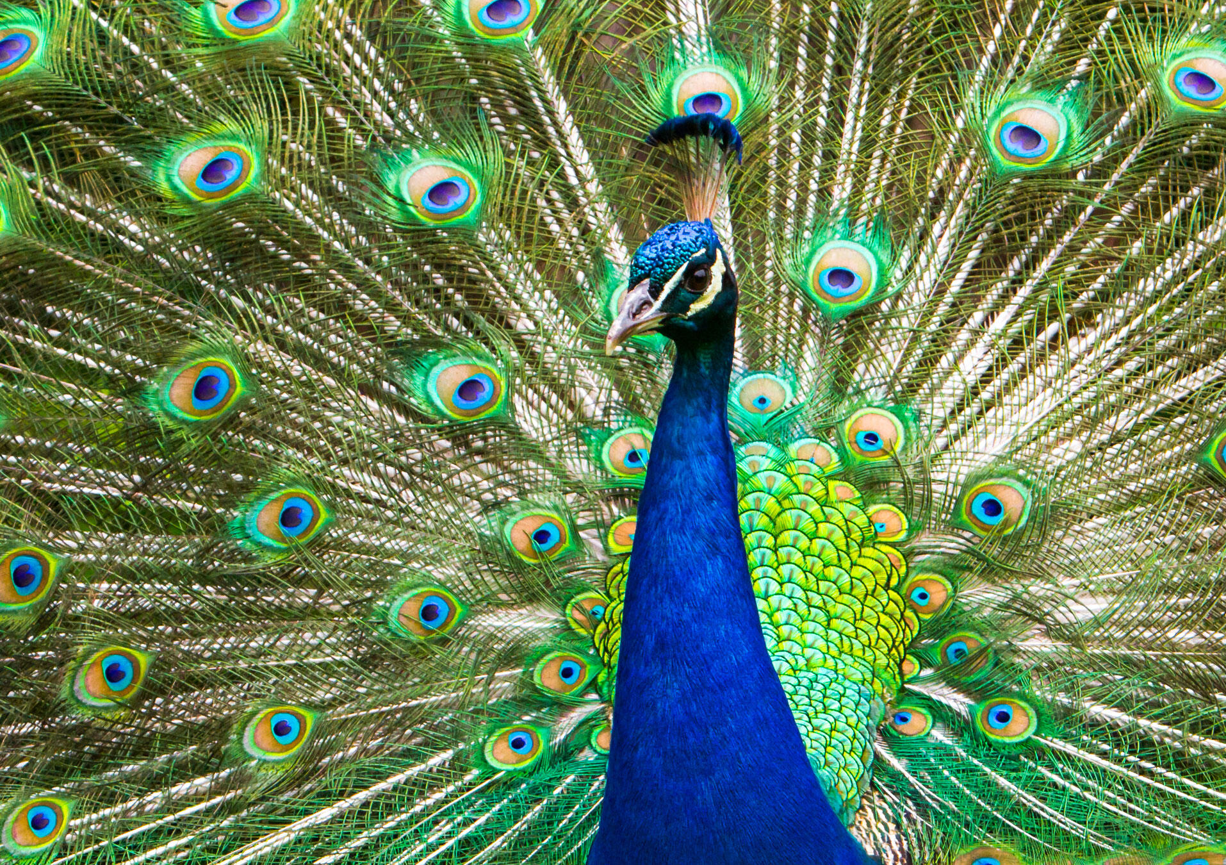
Type 3: Achiever
Characters: The Success-Oriented, Pragmatic, Adaptive, Excelling, Driven, and Image-Conscious
Key Motivations: Want to be affirmed and succeed, to distinguish themselves from others, to have attention, to be admired, and to impress others.
Basic Fear: Of being worthless
Basic Desire: To feel valuable and worthwhile
Healthy 3: Strong supporters, confident, articulate.
Unhealthy 3: People-pleasing, avoidance of conflict.
Famous 3s: Mitt Romney, Elvis Presley, Taylor Swift, Lady Gaga, Oprah Winfrey

Slide 7

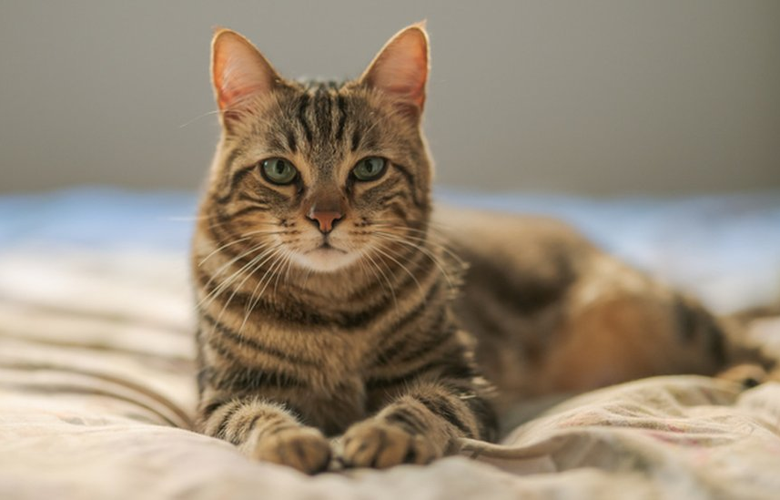
Type 4: Individualist
Characters: The Sensitive, Withdrawn, Expressive, Dramatic, Self-Absorbed, and Temperamental
Key Motivations: Authenticity, Individuality, Nobility, Creation of beauty.
Basic Fear: That they have no identity or personal significance
Basic Desire: To find themselves and their significance (to create an identity)
Healthy 4: Powerful culture-shapers, fine tuning systems and problems with ease.
Unhealthy 4: Unable to accept help, resentful for others’ presence.
Famous 4s: J.D. Salinger, Cher, Prince, Johnny Depp, Anne Frank, Edgar Allen Poe, Kate Winslet

Slide 8
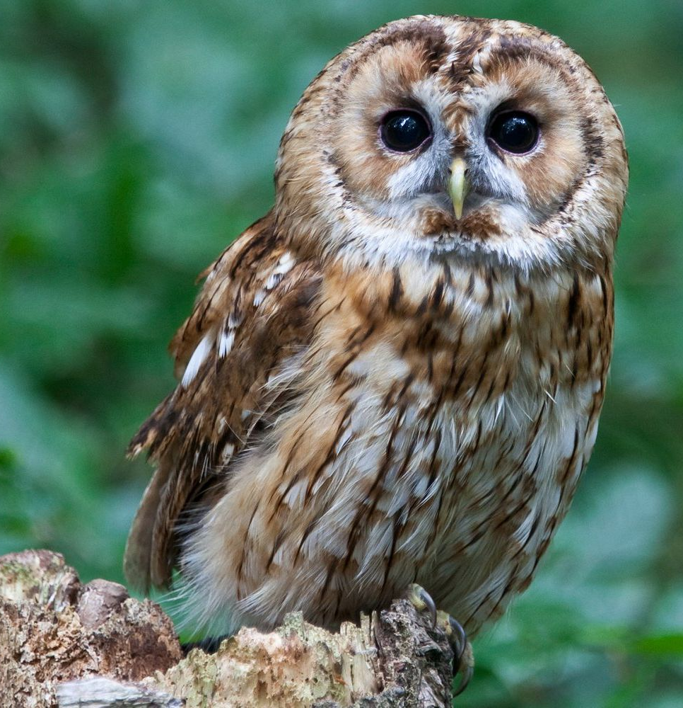
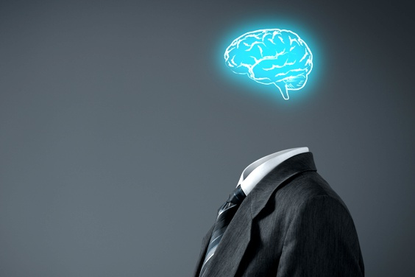
Type 5: Investigator
Characters: The Intense, Cerebral, Perceptive, Innovative, Secretive, and Isolated
Key Motivations: Want to possess knowledge, to understand the environment, to have everything figured out as a way of defending the self from threats from the environment.
Basic Fear: Being useless, helpless, or incapable
Basic Desire: To be capable and competent
Healthy 5: Challenge the status-quo and provide transparency and insight into surroundings.
Unhealthy 5: Hoarding, over-consuming and unable to be at peace with current surroundings.
Famous 5s: Georgia O’Keefe, Emily Dickinson, Agatha Christie, Buddha, Albert Einstein, Steven Hawking, Mark Zuckerberg

Slide 9
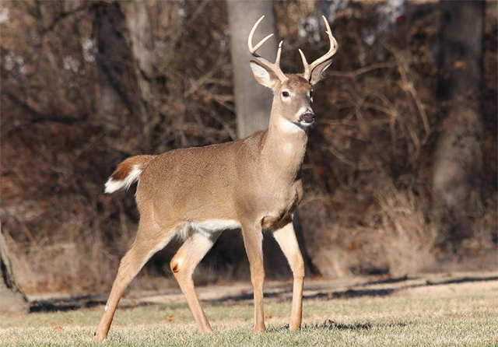

Type 6: Loyalist
Characters: The Committed, Security-Oriented Type: Engaging, Responsible, Anxious, and Suspicious
Key Motivations: Want to have security, to feel supported by others, to have certitude and reassurance, to test the attitudes of others toward them, to fight against anxiety and insecurity.
Basic Fear: Of being without support and guidance
Basic Desire: To have security and support
Healthy 6: Poised, trusting, and unifying for those around. Articulate and confident.
Unhealthy 6: Paranoid of distrust, deceitful, overly busy in hopes of coping.
Famous 6s: Marilyn Monroe, Katie Couric, George Constanza, Frodo Baggins, Princess Diana

Slide 10
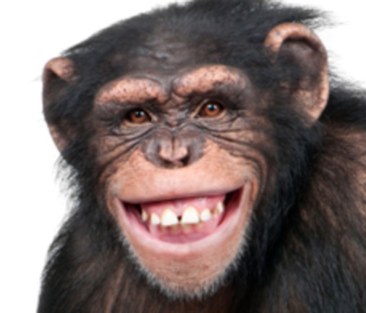

Type 7: Enthusiast
Characters: The Busy, Fun-Loving, Spontaneous, Versatile, Distractible, and Scattered
Key Motivations: Want to maintain their freedom and happiness, to avoid missing out on worthwhile experiences, to keep themselves excited and occupied, to avoid and discharge pain.
Basic Fear: Of being deprived and in pain
Basic Desire: To be satisfied and content—to have their needs fulfilled
Healthy 7: Open-handed, accepting of pain or struggle, and grounded in contentment.
Unhealthy 7: Scattered, looking for the next thing to solve, plan, or attempt.
Famous 7s: Amelia Earhart, Elton John, Miley Cyrus, Steven Spielberg, Jim Carrey, George Clooney

Slide 11
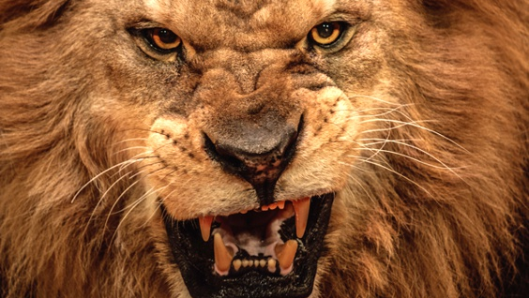
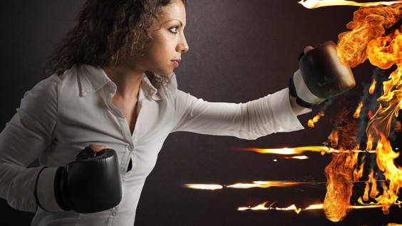
Type 8: Challenger
Characters: The Powerful, Dominating, Self-Confident, Decisive, Willful, and Confrontational
Key Motivations: Want to be self-reliant, to prove their strength and resist weakness, to be important in their world, to dominate the environment, and to stay in control of their situation.
Basic Fear: Of being harmed or controlled by others
Basic Desire: To protect themselves (to be in control of their own life and destiny)
Healthy 8: In touch with self & other’s needs, emotions. Vulnerable and self-restrained.
Unhealthy 8: Using confrontation as a means to obtain power. Pushiness and paranoia.
Famous 8s: Martin Luther King Jr., Aretha Franklin, Queen Latifah, Serena Williams, Pablo Picasso, Frank Sinatra

Slide 12
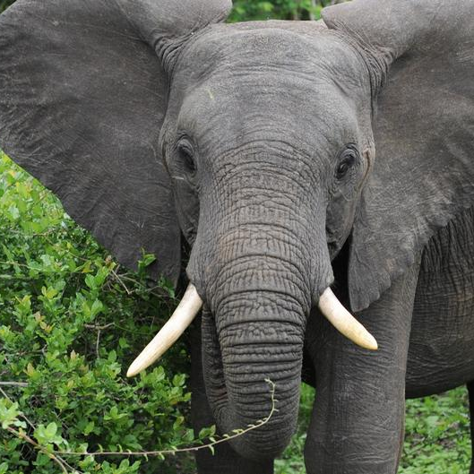

Type 9: Peacemaker
Characters: The Easygoing, Self-Effacing, Receptive, Reassuring, Agreeable, and Complacent
Key Motivations: Want to create harmony in their environment, to avoid conflicts and tension, to preserve things as they are, to resist whatever would upset or disturb them.
Basic Fear: Of loss and separation
Basic Desire: To have inner stability "peace of mind“
Healthy 9: Powerful accomplishments, creative drive, and visionary will.
Unhealthy 9: Inability to make decisions. Fear of change or making the wrong choice.
Famous 9s: Morgan Freeman, Walt Disney, Whoopie Goldberg, Tony Bennett, Janet Jackson

Slide 13

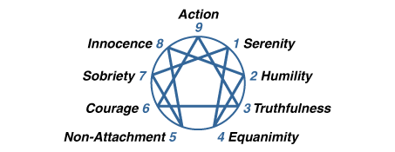
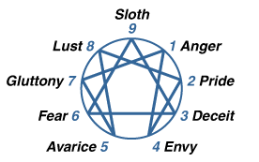
Heathy and Unhealthy

Slide 14
Call-To- Actions
Enneagram Test https://www.truity.com/
How to lead based on your enneagram?
How you are going to help people in your church, family, company, based on enneagram?
Share your type in our class
Notes:
Shorten the time to know people. Everyone has the different gifts and characters. 2 pastors: spread the gospel vs feed and develop the sheep.
1: Know yourself, like your strength and improve your weakness. Help you to see your blind spots (think other’s problem, like divorce, changing jobs). Be yourself and don’t be jealous of other. Forgive yourself: Type 6, careful, they forgive their anxiety. Type 3: Change the job all the time. Switch gear, when dealing with different type. Like Type 6 needs to prepare. Type 3, 8 needs big scale, for their tasks.

